Slide 1
portable sockets

Slide 2
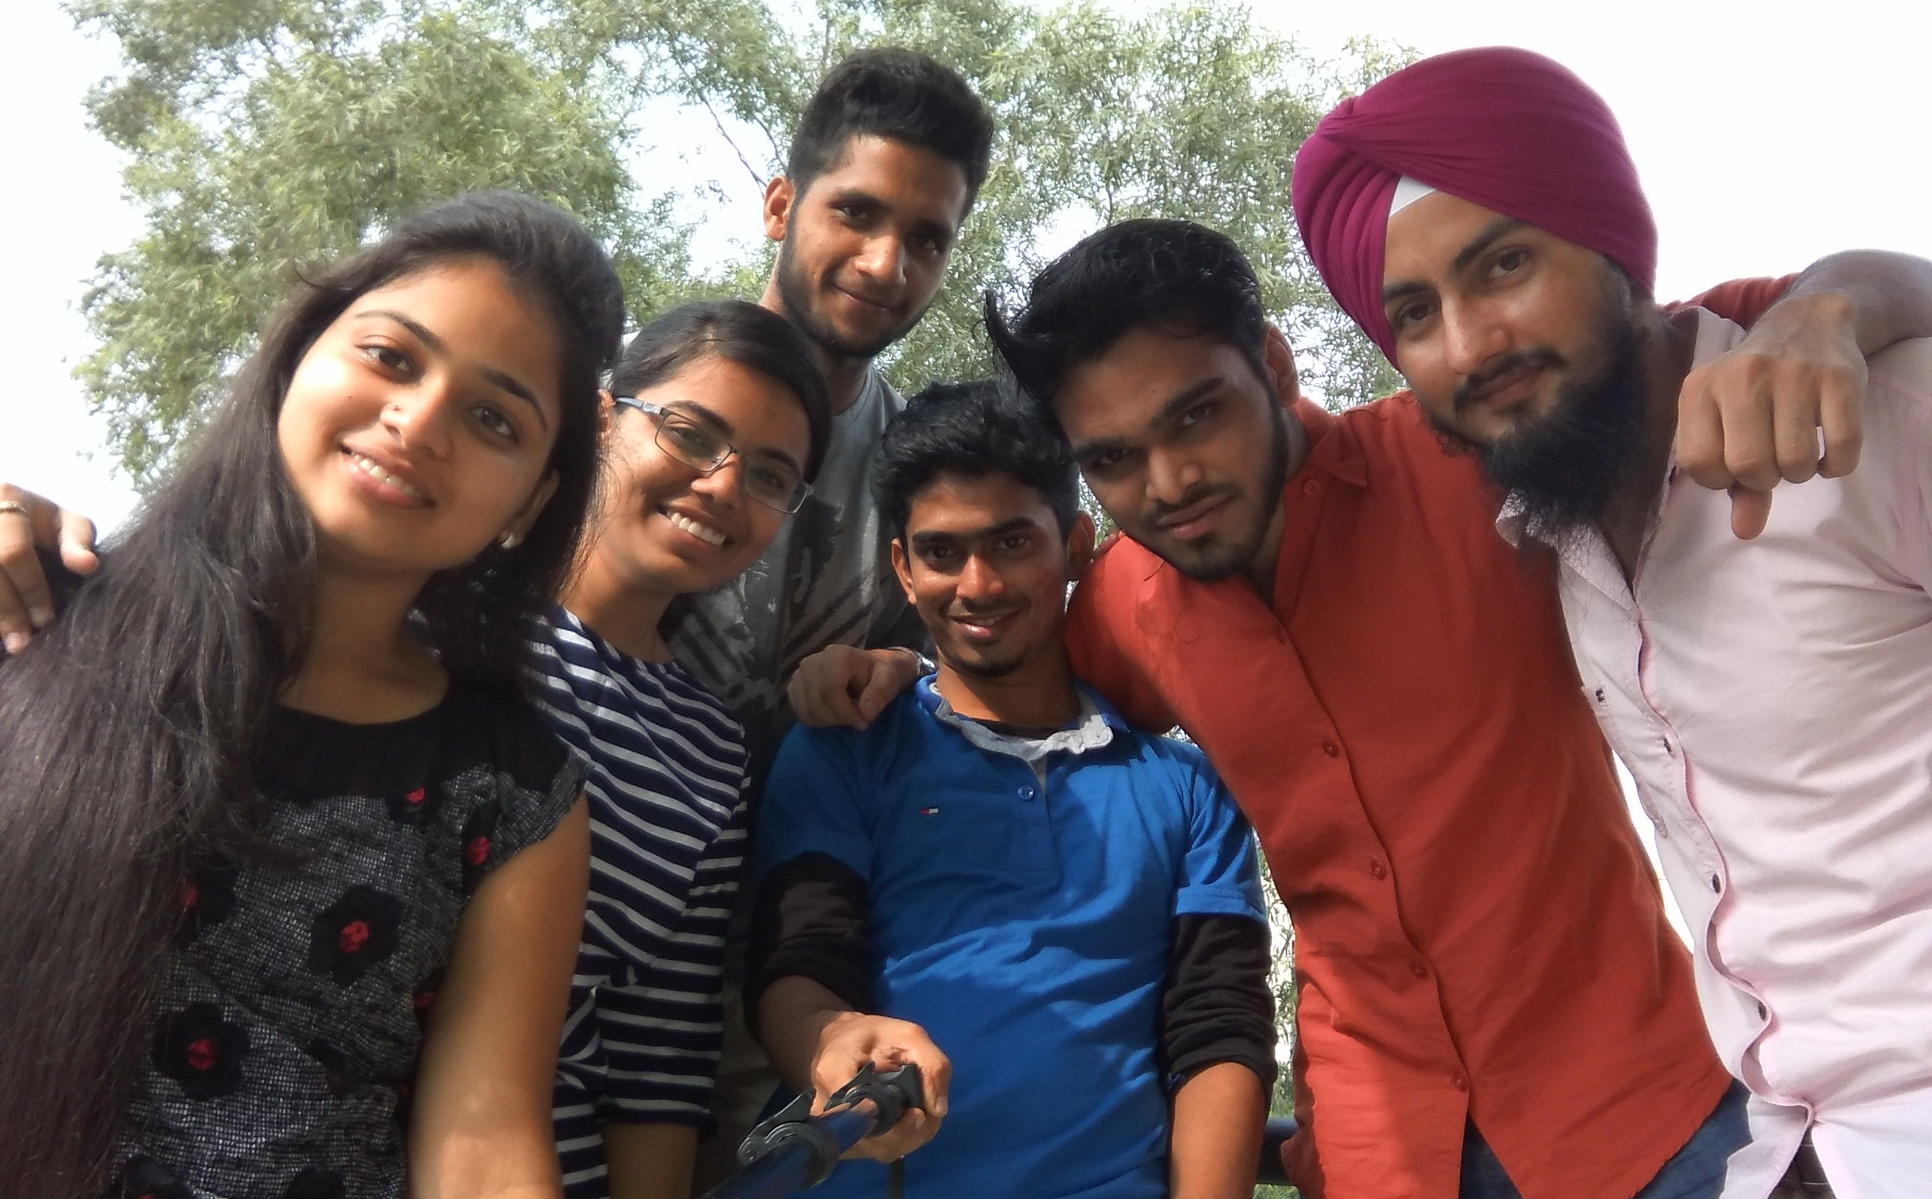
GROUP-4

Slide 3
Problem statement
People need more sockets because number of sockets available are very less as compared to needs.

Slide 4
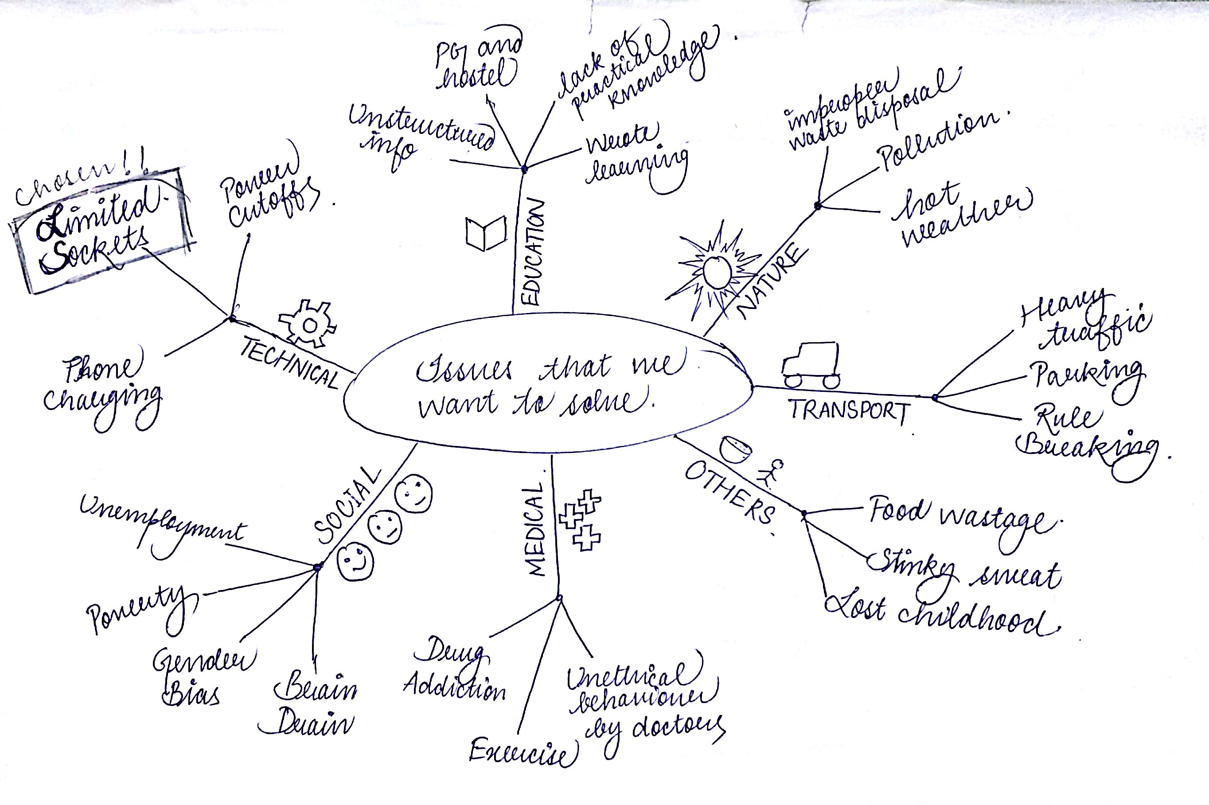
Mind Mapping

Slide 5
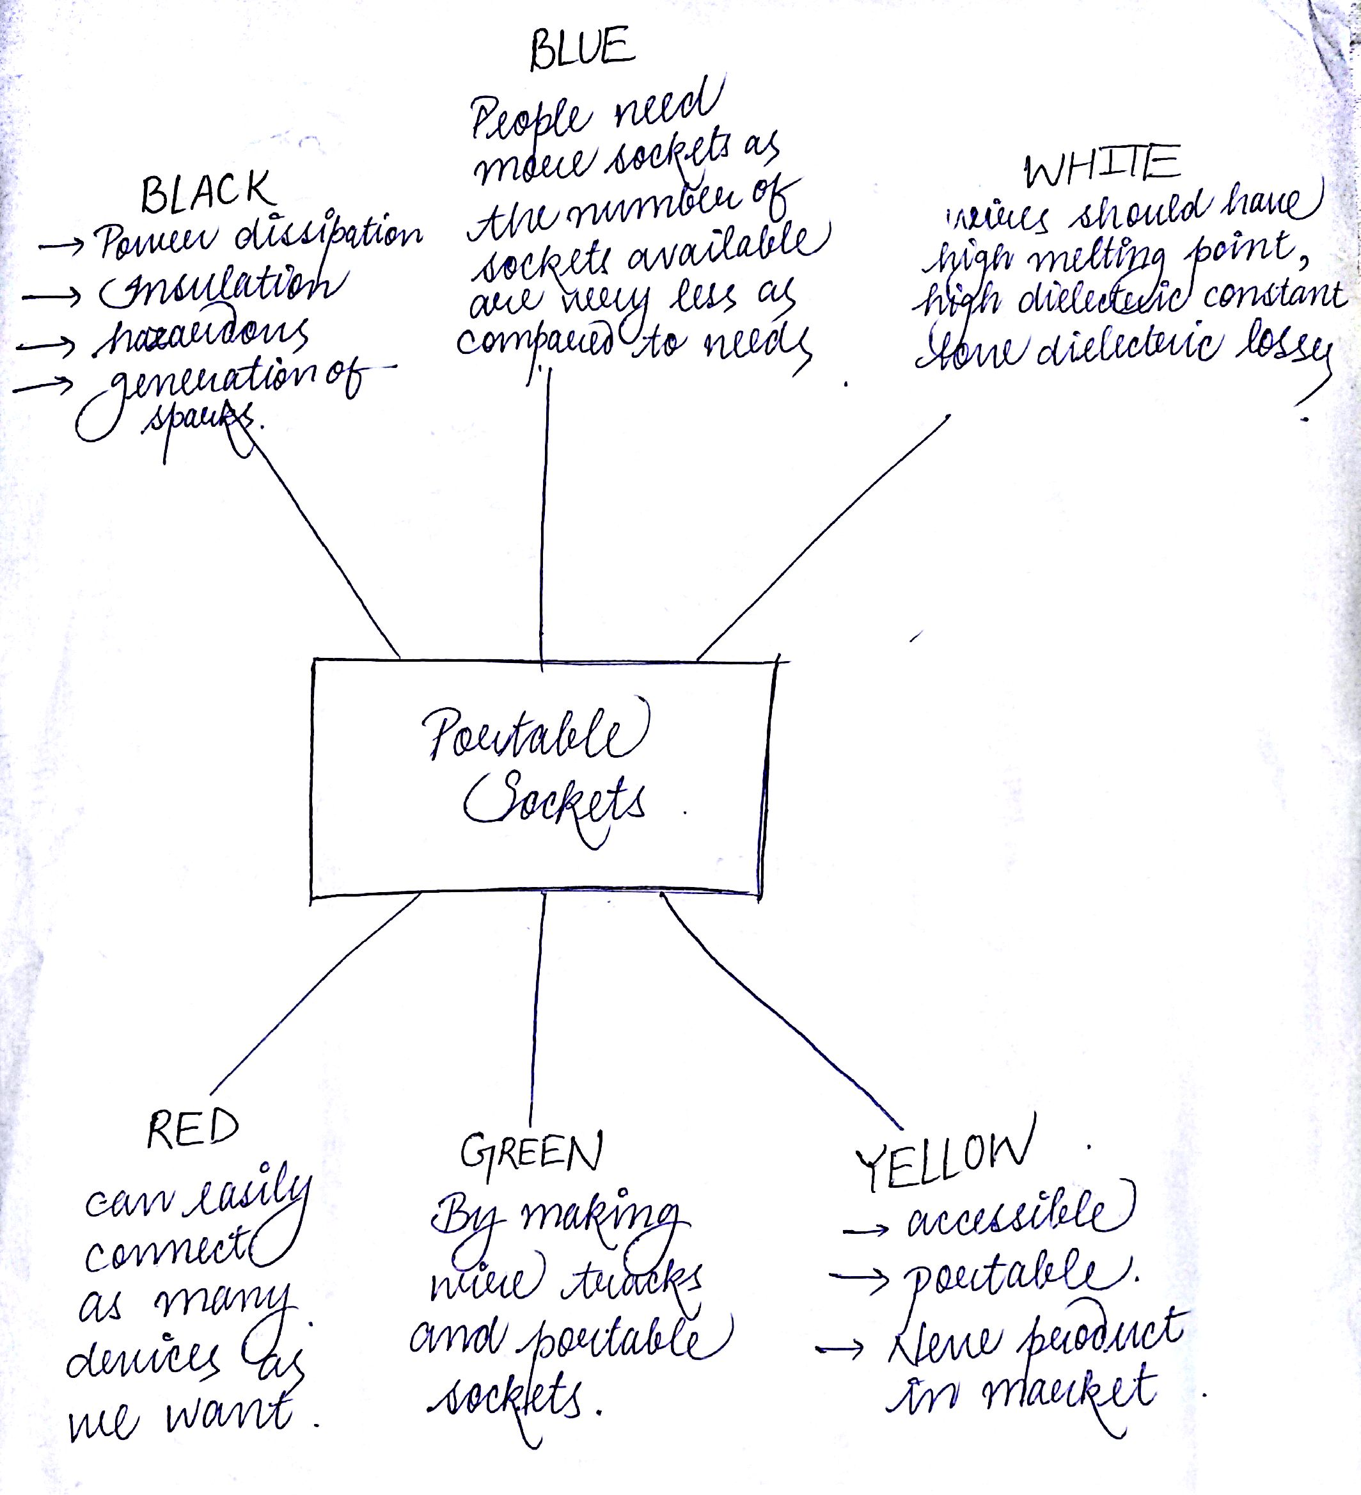
6 THINKING HATS

Slide 6
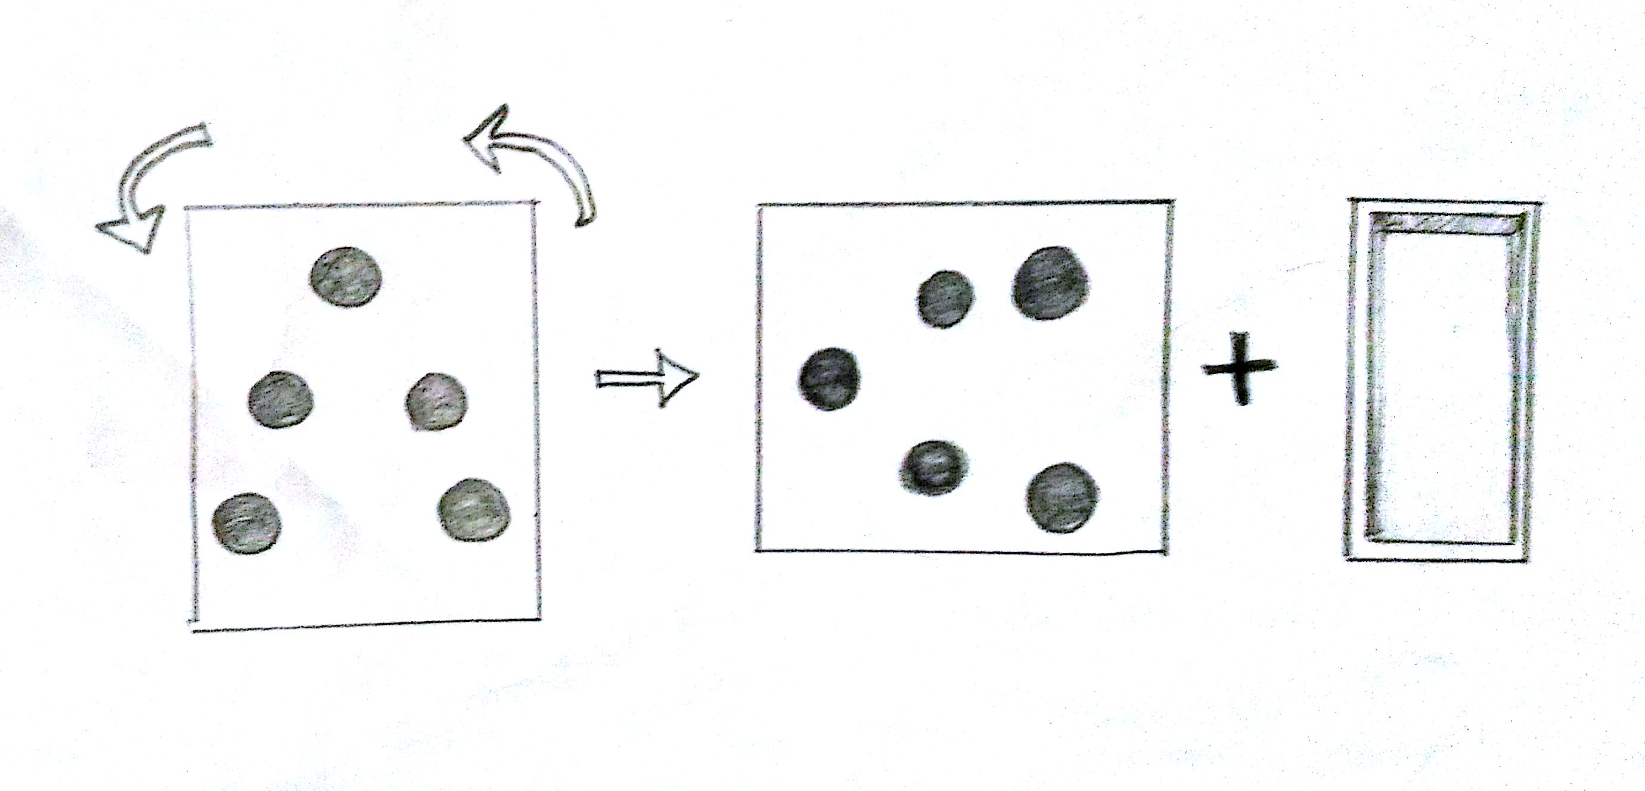
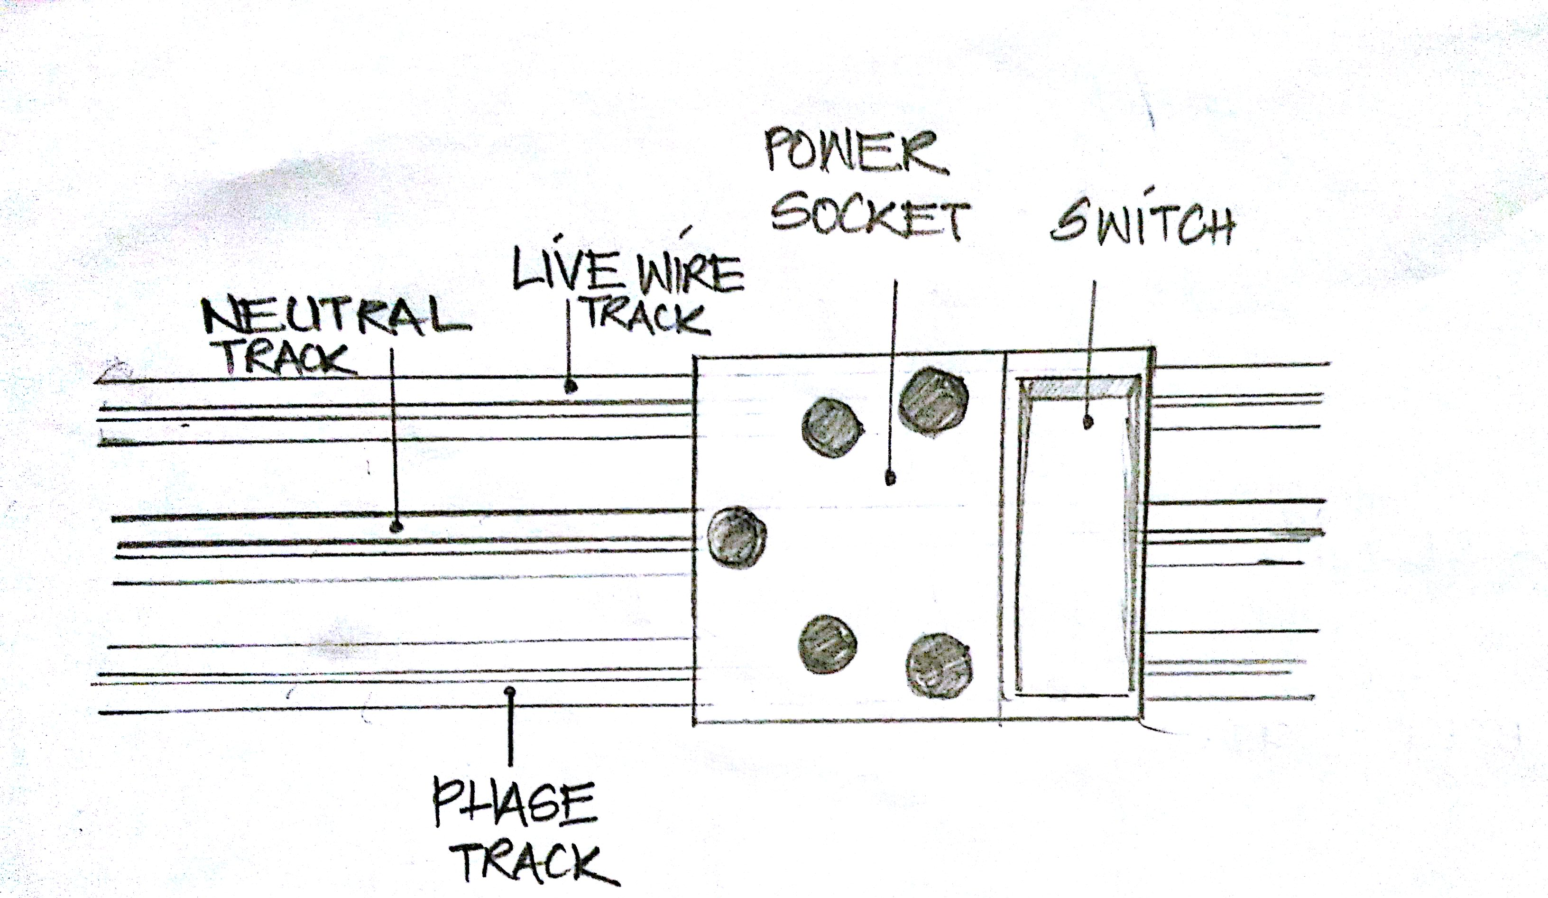
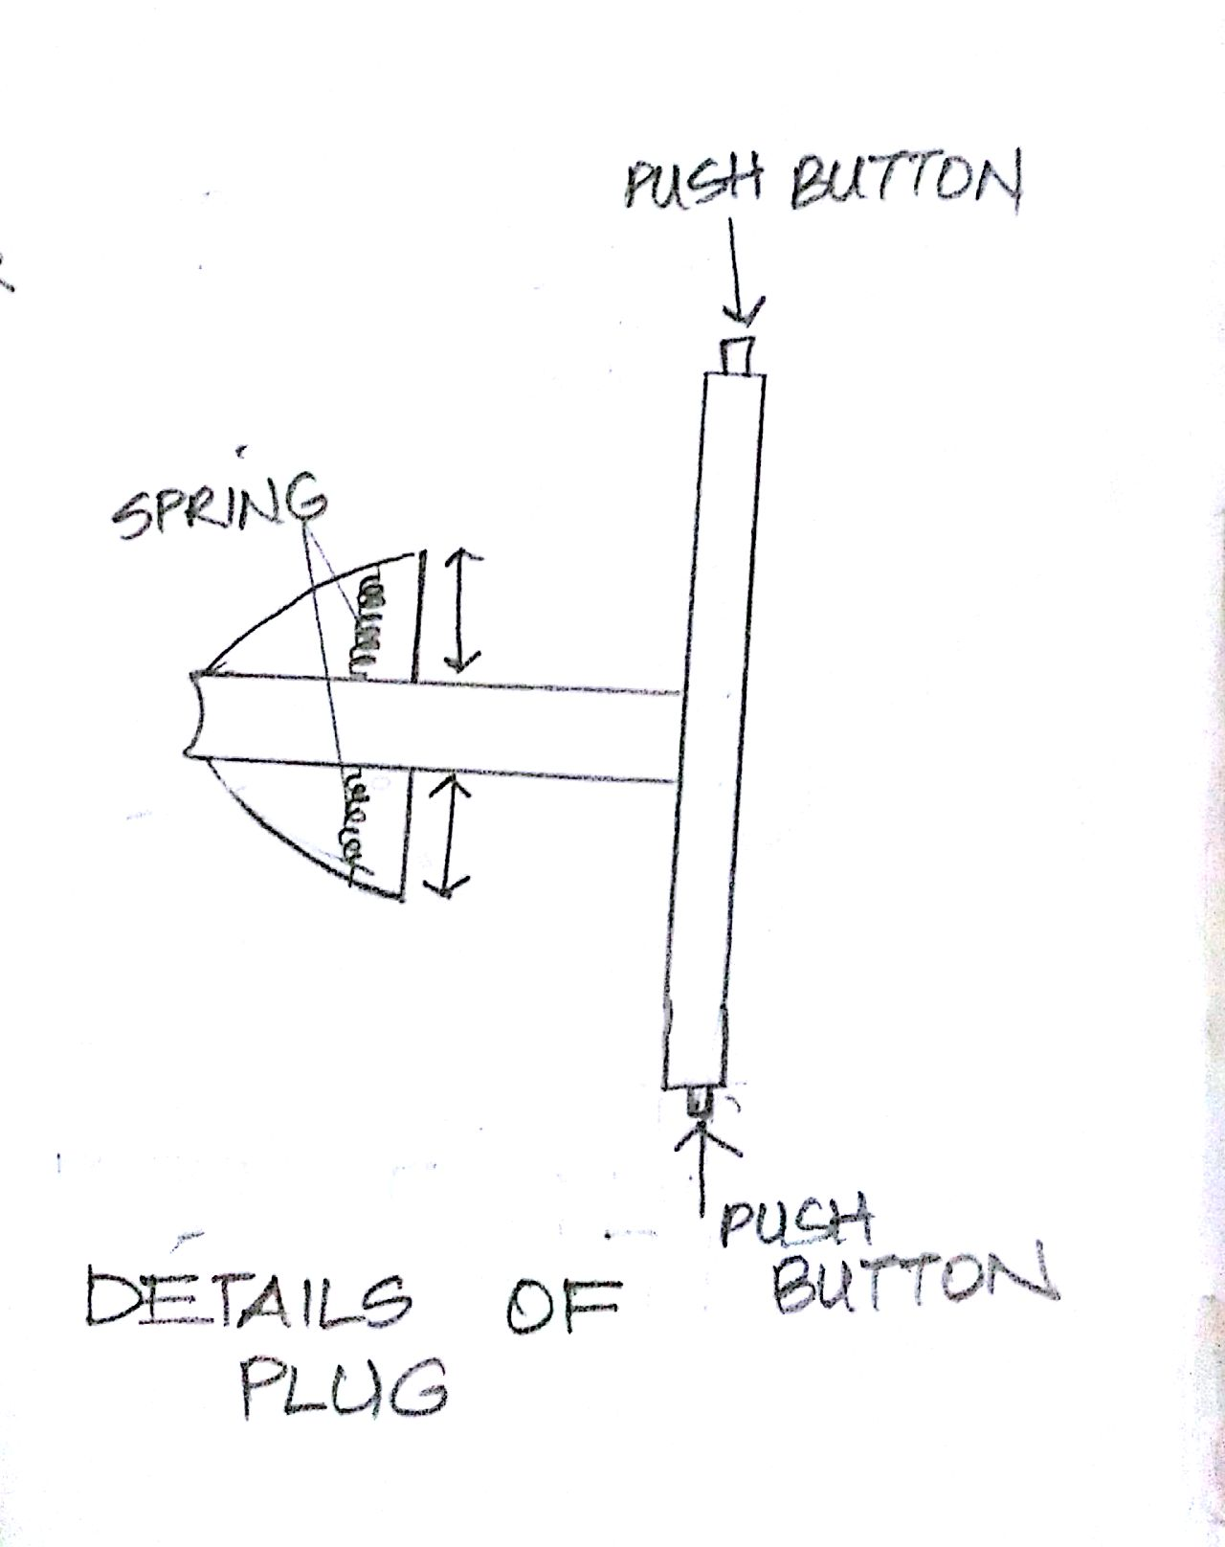
DESIGN

Slide 7
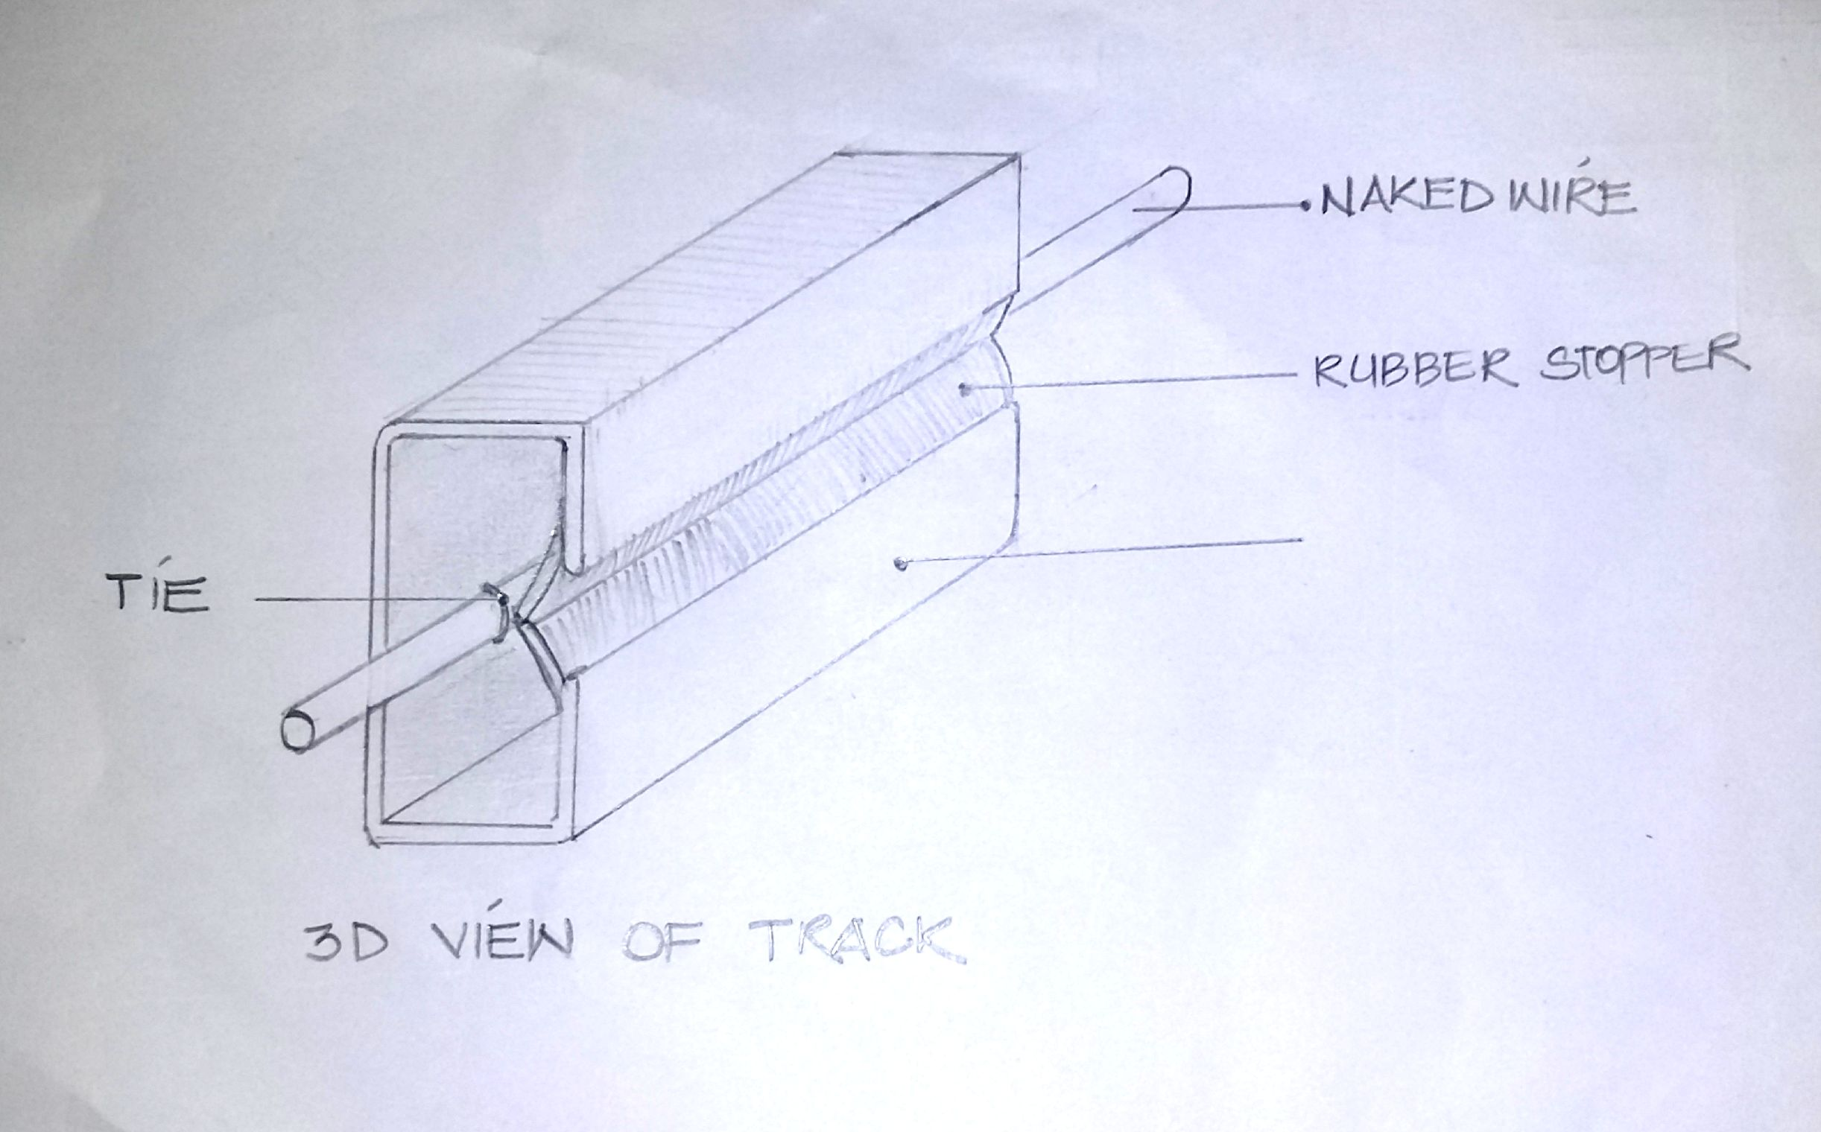
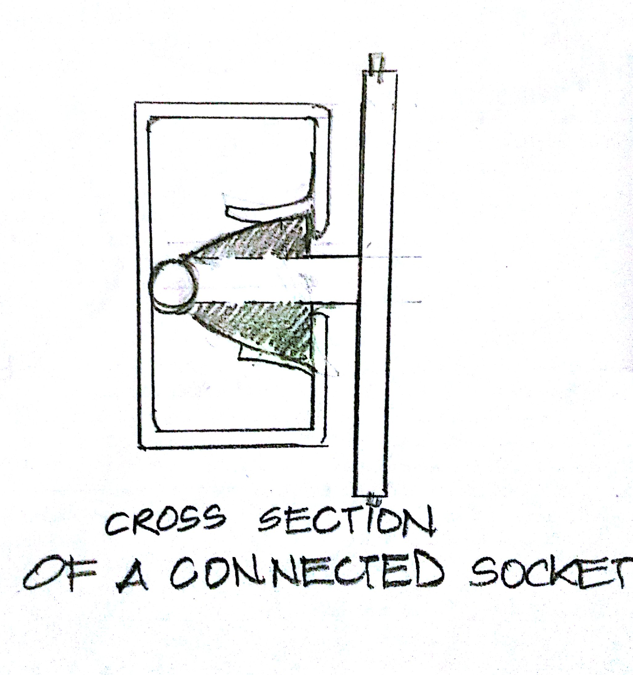
DESIGN

Slide 8
EXECUTION

Slide 9
EXECUTION

Slide 10
Market Opportunities
A whole new system of sockets
A new product
A creative idea which can be used for advertisement

Slide 11
HELP NEEDED
Funding from company.
Information regarding materials to be used.
More research on topic.
Permission from government to implement this idea.

Slide 12
?

Slide 13
Presented by:
Gaurav Kumar
Tejashri Patil
Saghan Agarwal
Nancy Hada
Gurpreet Singh
Arshad
THANK YOU!

